Slide 1

Designing With VHDL
By Neha Murthy
Notes:
Hi, my name is Neha Murthy and this is my project

Slide 2
INTRODUCTION
I used the Zybo Z7 board as I wanted the specific blue, red, green lights to show (to demonstrate the state)
Digital Security Lock
Simon Says
Though the idea in the future would be to combine the two projects to make a digital lock with a memory twist in the end, at the current point,, as they serve as two different projects, one part of it serves as security lock and the other part serves as either for entertainment purposes or research/ therapy purposes.
Notes:
I have a design that comprises of two projects into one. They were meant to be integrated into one project, however, due to time and errors occurring at the last minute, I didn’t want to affect any working pieces. The first project was a lock of some sort where the user can type a number of letter from the Keypad which its design acts like a matrix and that number or letter then displays on the SSD. The keypad is a 16 buttoned arranged in a hexadecimal format from 0-F. By going through each column and reading each row, we are able to understand which button was pressed. If I had more time, I was going to write a validation for it and maybe, if there was a motor, then I could have attached it if a correct number was inputted, turning it in a certain direction.
The Simon says game was my vision of a kids lock system which keeps them entertained, but is a lock. In other words, kids could develop cognitive abilities, having entertainment while playing. There were actual research on Simon says and how it impacts the brain development.

Slide 3
TABLE OF CONTENTS
01
02
Concept Inspiration
General System Description
03
04
Problem Solving
Application Space
05
06
Market End User
System Block Diagram
07
08
Implementation and Challenges
Summary
Notes:
In this presentation, I will go over these topics.

Slide 4
Concept Inspiration
Digital Lock (security feature)
Simon Says Memory Game → solve memory patterns
Statistics:
On average, 3,062 burglaries happen in the U.S. every day.
A property crime takes place every 4.4 seconds in the US.
Future Improvements to the design (Digital Lock)
Validation of the keypad input
Maybe add a pmod or device that will move in a direction to understand unlocked or locked
Future Improvements to the design (Simon Says)
Since it serves as a lock, it can also have a pmod or device to move in a direction to show unlocked or locked
Notes:
The idea stems from the desire to create a fun project that is interactive and engaging and can be used in both recreational and practical real world situations. It will allow the user to enter their passcode and it will display on the SSD. Due to time constraints, I wasn’t able to validate the passcode. With more time,we could incorporate a motor to demonstrate locking and unlocking.
The ‘Simon Says” part of the design also has an education value as it is a memory game that would simulate cognitive skills like memory, attention, pattern recognition, and so on. This portion of the design can be used in education but also, in medical facilities, in therapies. This can also serve as a small kiddish lock system, something that they can have fun with but also learn and improve their abilities. The idea with this, is if the kids can enter the right passcode, with some number of tries, then the kid can open their safe.
As there can always be improvements in the future, some improvements include customization of the difficulty level for Simon Says, allowing more flexibility and features for the authorization.

Slide 5
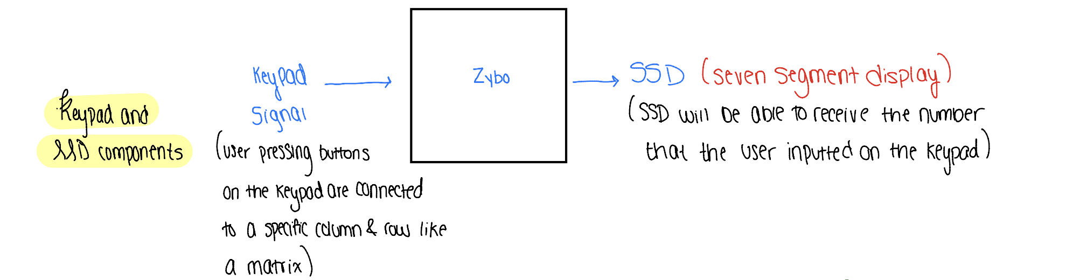
Digital Lock-
General System Design
PMOD: KYPD and SSD
User will input a two-digit or letter number through the keypad and that number will display on the SSD
Notes:
The design for the digital lock is there will be a keypad and an SSD connected to the board. The user is able to enter a digit or letter passcode into the keypad and the SSD will be able to receive that number. The SSD will hold the value that the user inputted. This was the extent to how much I was able to get done on this portion of the project, however, as mentioned before, with more time, I would do validations, and much more.

Slide 6
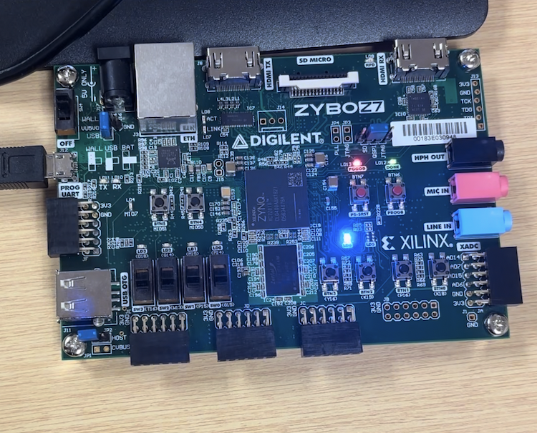
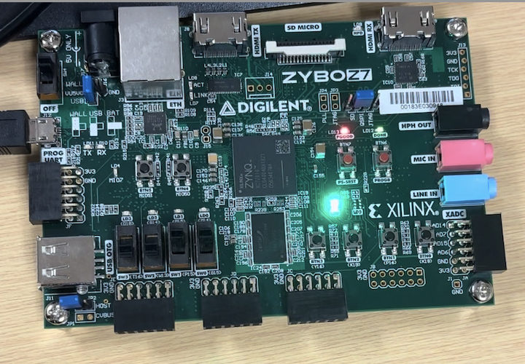
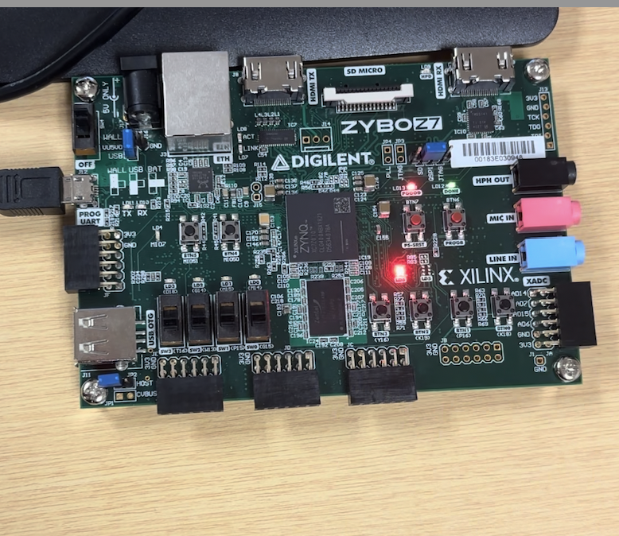
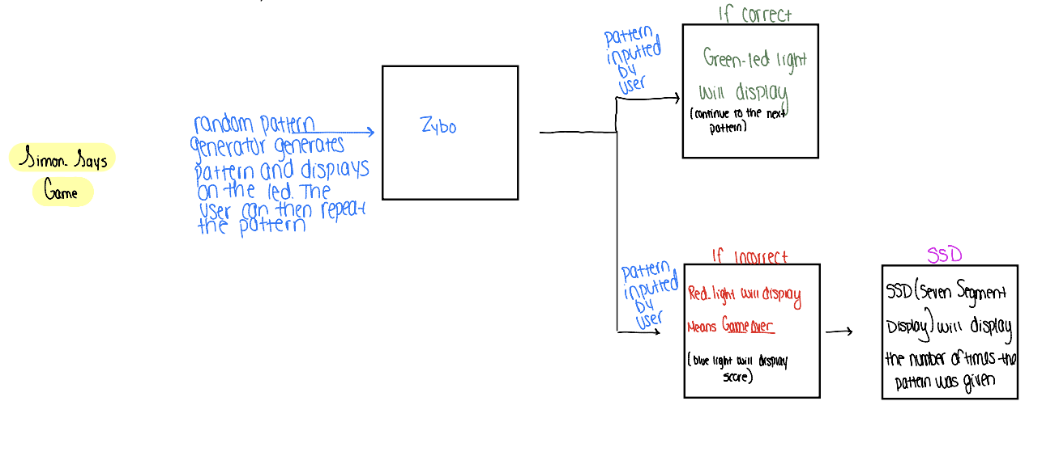
Simon Says-
General System Design
Main: A memory testing game where the user much replicate a pattern that is generated
If CORRECT: Green Light and new pattern generated
If INCORRECT: Red Light will blink indicating that the user put in a wrong pattern and the game is over
Blue LED light will blink indicating the score (# of times the user put the correct sequence before inputting the wrong sequence)
Notes:
The design is “Simon Says” where there is a random pattern that gets generated on the board and lights up. The user has to input the same pattern correctly. If they do it correctly, then the board will display a green light. That would indicate that the correct pattern was inputted. If they put it incorrectly, they the red led light will glow indicating that it was wrong. When the user gets it wrong, then that’s gameover. A blue LED will light up the number of times that the user put it correctly. Simon Says can be the kids version for entering the passcode for their safe. This can also be treated as a game enjoyed by all. This can be seen through the general system block diagram that I drew.

Slide 7
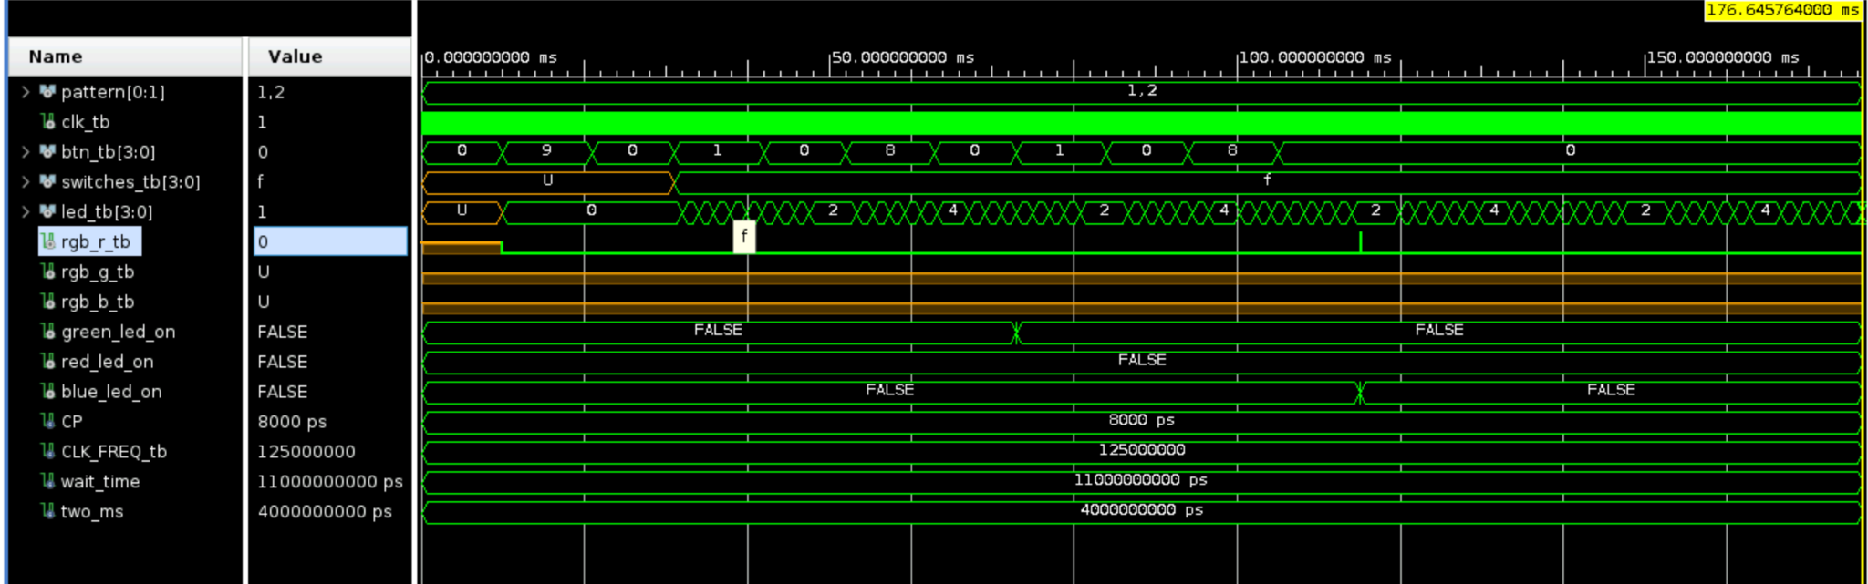
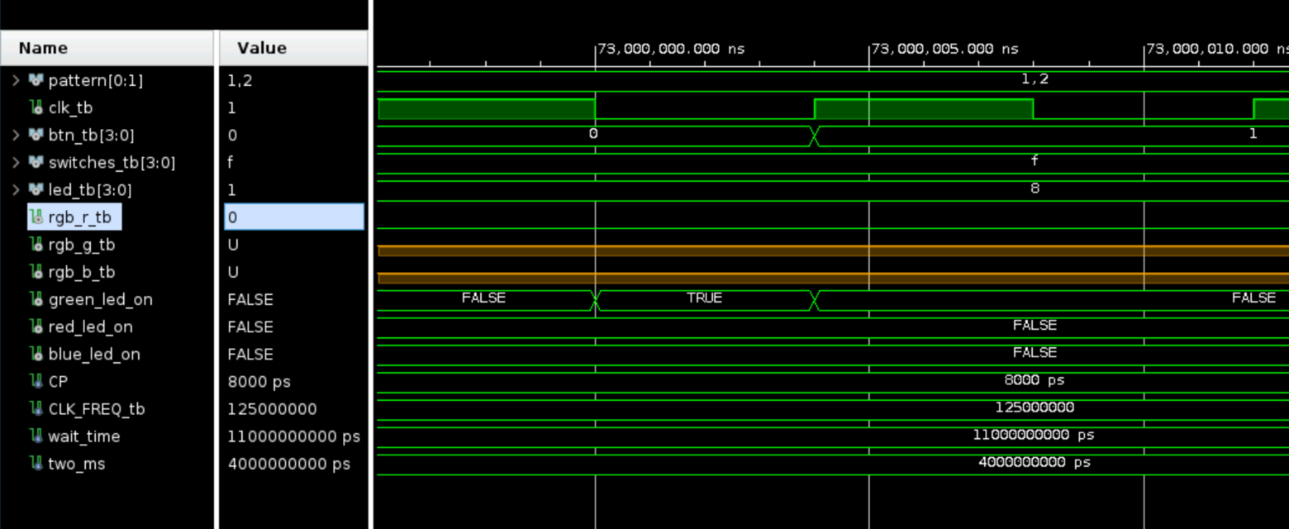
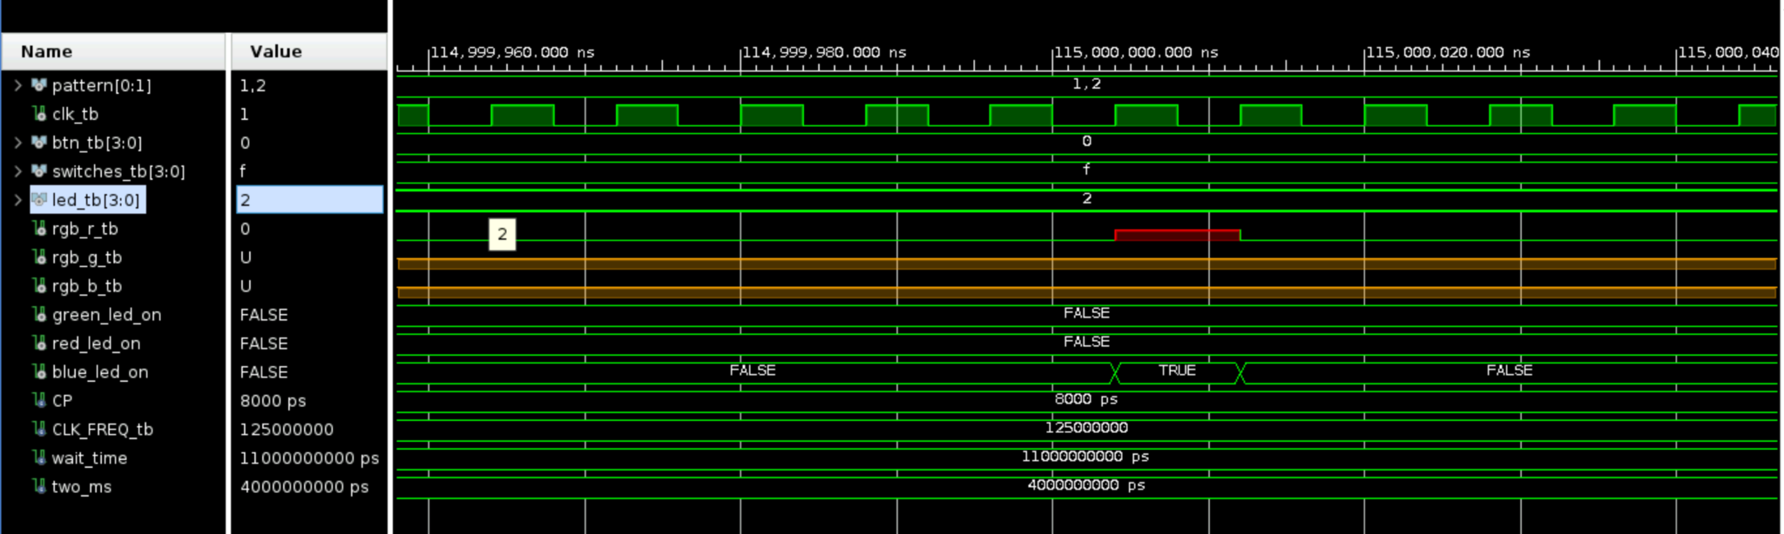
Testbench- Simon Says
Notes:
I had created a testbench with one correct and one incorrect pattern where it would show me that if a pattern matched, then the green_led would turn on for a very little time and then switch off again. If the pattern was wrong, then the red_led turned on for a little bit and right then, the blue _led turned on. This shows that when the greed_led turns on, then the next pattern will show and wait for the user input. If it is incorrect, then immediately the red_light will turn on and the blue_light will show how many times the user inputted a correct pattern. I had tested here one correct pattern and one incorrect pattern.

Slide 8
Problem Solving
Problem in the real world:
Home invasions; break ins
Statistic: On average, 3,062 burglaries happen in the U.S. every day
Solution: Home Security Alarm
Notes:
The problem that is being solved is home invasions as this project was originally a lock, but also a developmental project, helping with memory. Statistically, on average 3,062 burglaries happen in the US every day. In that case, we are trying to create a security lock, where the user has the option to type a letter or number to unlock. With future designs, we can create more security factors. There could be improvements like the button rapidly blinking if the alarm is triggered or allow the user to re-enter the code.

Slide 9
Application Space
Security:
Security → Digital Lock
Can be used for home doors, for safes (anything that protects something)
Residential, Commercial buildings, education institutions, healthcare, government, etc.
Medical Facility:
Simon Says functions as memory game that can improve a person’s cognitive ability. Idea is if doctors and therapists are trying to improve a person’s cognitive memory abilities, they can use this device for patients to remember entry codes and be engaged with the game that follows it.
Entertainment: Taking the project separately,
The game serves as entertainment as it allows engagement with friends and family. It creates competition as many people can take turns to play and compete with each other.
Link (Article where facts of benefits of the game Simon Says): https://facts.net/lifestyle/entertainment/19-captivating-facts-about-simon-electronic-memory-game/
Notes:
For application space, since this is two separate projects combined into one, together, it can serve as a digital lock with a twist in the end with a memory game/ authorization. As mentioned before, the digital lock would be used for security purposes but also, the aspect of the simon says game can also be used in medical facilities and entertainment. In medical facilities, doctors and therapists can use the game to improve a person’s cognitive ability. As per an article, Simon Says has been used in research studies on memory and cognition. The game would use hand-eye coordination and quick reflexes and can be enjoyed by people of all ages as entertainment, played competitively.

Slide 10
Market End User
Digital Lock:
This is mainly for:
Residential Users
Buildings (commercial, educational, financial, etc)
But also can be used by medical doctors and therapists
Simon Says:
This is mainly for:
Children and Families
Educational Institutions
Therapists, Medical
Special Needs Communities
Gaming
Research
But also can be used by medical doctors and therapists
Notes:
For market end user, I will discuss the digital lock that encompasses both designs as well as just the simon says design on its own. For the digital lock, it can be used for residential users.
Now, for Simon Says, the market caters to a wide range of end market users. Children and families can use it as Simon Says is a popular game. Since, all the traditional games have moved to electronic ways, this serves as a Simon Says competitive game for many to play. This can also be used in Education institutions as the game can be used in programs and events, Teachers of lower grade levels can incorporate a fun lesson to promote cognitive development and social skills for kids to play with each other. It can be used in healthcare industry as therapids can use the game for sensory integration ( visual), or cognitive training, quick motor skills, used in the special needs communities and can be designed to accommodate their abilities. It can be used in gaming industry and research institutions, in fields like psychology, neuroscience, and so much more.

Slide 11
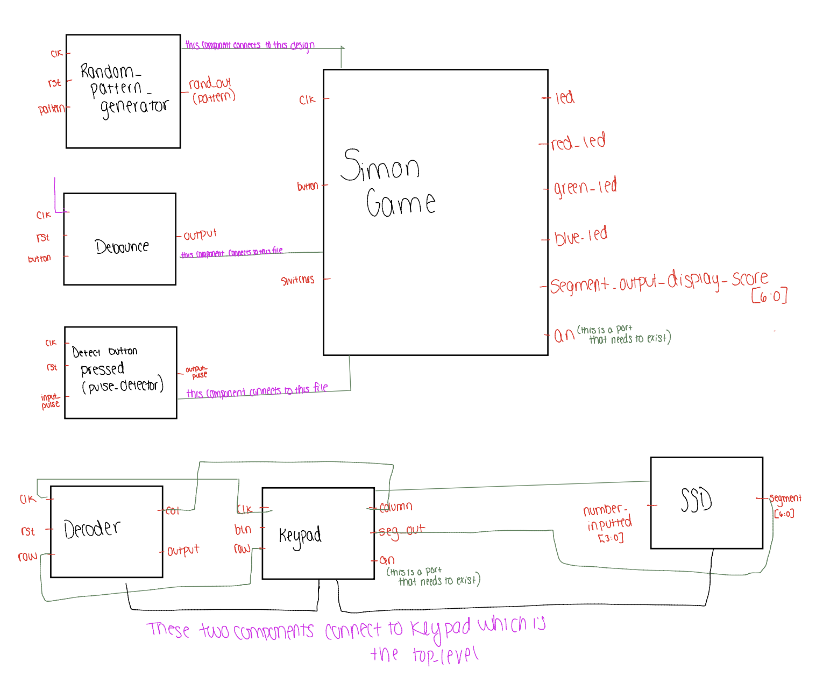
System Block Design
Notes:
My system diagram is as such. My entire project is really about home security mechanisms, but also with a twist of an entertainment project. There are two projects that I was trying to create and then combine into one, however, the integration wasn’t successful as I was met with no time. The idea was that there was a Simon Says game but also a “safe” that small kids can have. This will allow them to have a safe, but a safe that keeps them entertained. However, since locking validations weren’t done, it can also serve as a game to help with abilities, as per what research has said.
The other project is a digital locking mechanism which ultimately would allow the user to get input from the user on a Keypad and the exact number would then display on the SSD. Had I had more time, my idea with this was to validate the passcode and put some kinds of motor or some part that would have rotated a specific way indicating lock or unlock. In this diagram, I am trying to show that the random_generating,debounce and pulsed detection are all components that are combined into the simon game. The decoder and the SSD components integrate together for the Keypad. This entire diagram represents the project.

Slide 12
Implementation and Challenges
This design would be off the shelf as this is something that would be common for everyone.
Customizable→ the user can set it to their preference
If I was to create the two projects into one, then it would be a General Purpose Processor as it would hold two kinds of locks/projects
If I was to keep it as two different projects, then this would be a single purpose processor as each project has its own functions
This project is a Soft Core Processor as it utilizes LUT, FPGA, Flip Flops, Rams
Challenges : I had exams every day which didn’t allow me to come back to lab and have time to work on my project with the board so time was a bit constraint. Since this was the case:
I wasn’t able to have time to successfully complete and integrate my entire project into one
Notes:
This design can be off the shelves as this is a design that would be common for everyone, whether it be the game Simon Says, the safe simon says, or the lock. However, within the game, it can be customizable for the difficulty level that the user pleases. If I was to combine the two projects and have one device where both can be done, then this would be like a general purpose processor. However, as these are separate, each is like a single purpose processor, functioning separately and differently.
This project is a softcore processor and this was implemented using programmable logic resources that are available in an FPGA, like LUTS, Flip Flops, Rams. This means that the logic can be implemented in a wide range of devices.

Slide 13
Summary
Design of Simon Says was a success (with more improvements to be done)
Digital lock is very basic as of now→ back to the drawing board, as it can definitely be something that can be improved to something much more
Design Extension (Version 2.0):
For Simon Says, if I was to keep it as a game, along with the SSD, with more advance features, maybe we could include sound where there is a camera and bluetooth. When “Simon Says”, touch your eyes and the camera sees you doing that, then it would give you a point.
If we are using it as a safe, then definitely validations will be needed as I would have to make sure that if a certain number of sequences were right, then open. Maybe, the user can chose the difficulty of the pattern
For Digital lock, definitely, that needs a lot of changes. We would change it so that when the user puts the code and displays on the SSD, it would either move a motor, or ring a buzzer, show on the computer, etc.
Resource Limitation
Time was a huge factor as I had 3-hour exams most of the days and that took away the lab time from me
Technology was another huge factor as there were many times that the computers I was working on wouldn’t connect to the board or run the program.
Attached is a link to my report :
Notes:
In summary, my design was a version of the game “Simon Says”. In detail, “Simon” , the board will generate a random pattern of LEDs blinking. It will start of easy and continue to get harder as the user inputs more and more attempts.
I would say that the design of Simon Says was a success (with more improvements to be done), but since the digital lock is very basic as of now, I would say that that is back to the drawing board, as it can definitely be something that can be improved to something much more.
For design 2.0, if I was to keep Simon Says as a game, I think it is good as it is, and I can probably advance it by adding camera sensors and speakers.. When “Simon Says” to touch your eyes or something and you touch it, then the camera would sense it and give you a point.
If I was to keep it as a safe, I need to add validations and customizable on difficulty level of the patterns as it can be used by people of all ages
For the Digital Lock, it will need to be completely worked out again and I could include a lot of features like the motor unlocking or locking, maybe a sound buzzer or rapid LED lights going off if the alarm was triggered.
For resource limitations, I would say it was definitely time because I had 3 hour exams every day so I would come in a 9am and leave for my 3 hour exam, and by the time, the boards would have to be given back. So time was a huge factor and constraint for me and technology as there were many instances that I had wasted a lot of time because of the computer wasn’t able to run the bitstream of generate a simulation.

Slide 14
Thank you!
Notes:
Thank you and I hope that these slides were able to explain what my project is. Though the project is not completely finished, this was my vision for it.

